Slide 1
Make Your Work Openly Accessible
Preprints: manuscripts of finished papers (whether or not they have been accepted for publication by a journal)
Why digital circulation of preprints?
Get feedback, extend your readership, increase visibility of your work
Open Access increasingly a requirement for many funders and governments (e.g. UK, France, Australia)
[Green] Open Access = Readers can access your writings free of charge
Notes:
<number>

Slide 2
PhilSci Archive: the Preprint Archive for Philosophers of Science
Deposit preprints free of charge
Papers can be viewed and accessed without the need for a user account
A service to philosophers of science, by philosophers of science
Feeding automatically into PhilPapers
http://philsci-archive.pitt.edu
Sponsored and supported by
Philosophy of Science Association
Center for Philosophy of Science, University of Pittsburgh
University Library System, University of Pittsburgh
Notes:
<number>

Slide 4
Notes:
<number>

Slide 5
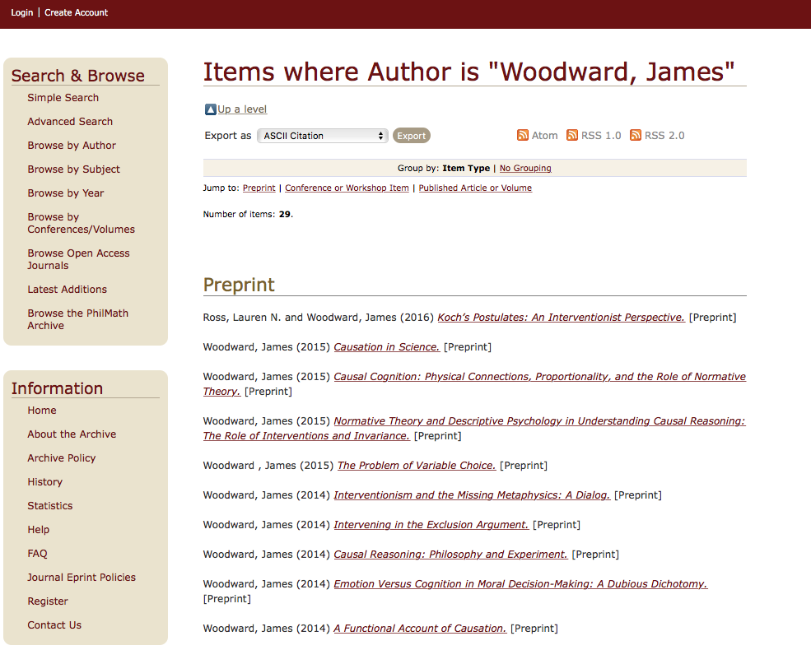

Slide 7
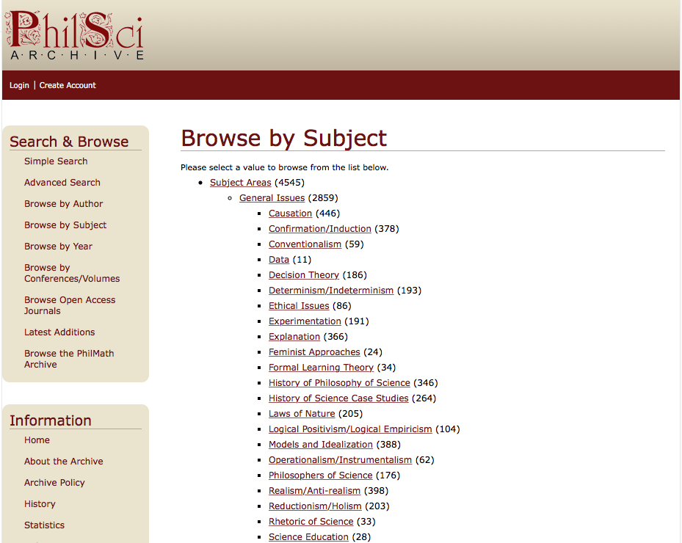
There are currently over 5,500 articles in the archive
Notes:
<number>

Slide 8
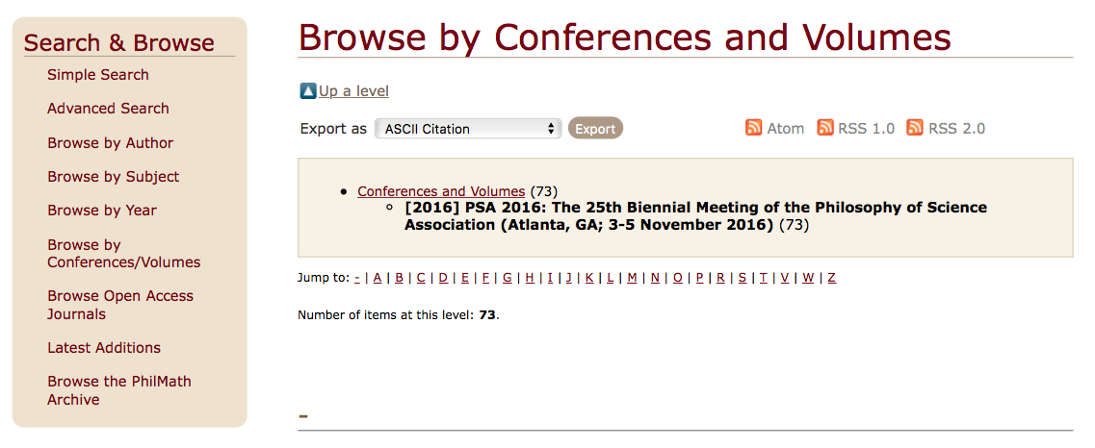
Special sections for conferences and workshops
Notes:
<number>

Slide 9
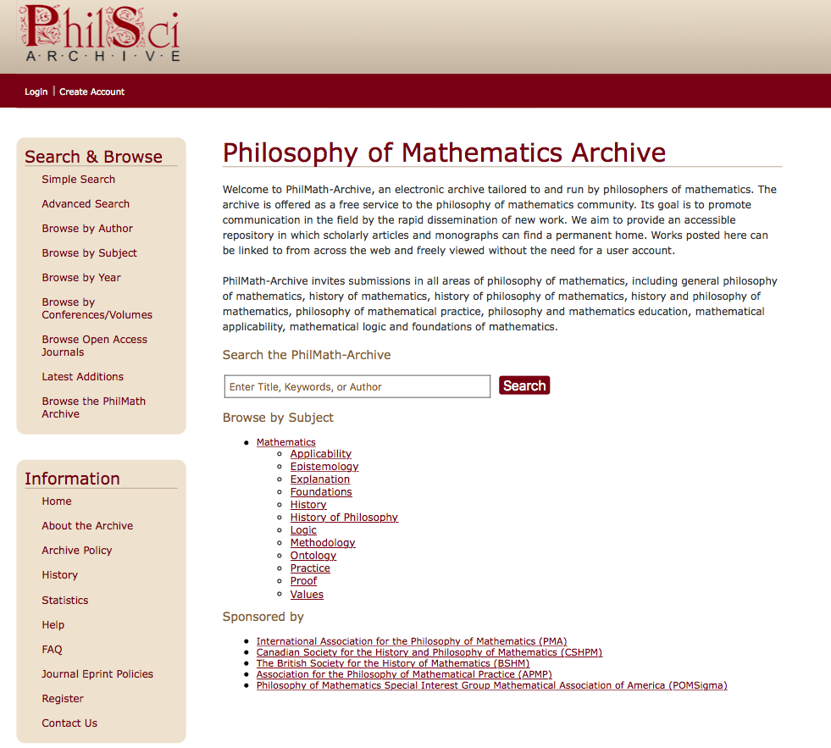
The PhilMath–Archive is now launched!

Slide 10
Sharing your preprints on the PhilSci-Archive is supported by many philosophy of science journals, including…
Philosophy of Science
Biology and Philosophy
Synthese
British Journal of Philosophy of Science
Acta Biotheoretica
Studies in History and Philosophy of the Biological and Biomedical Sciences
Studies in History and Philosophy of Modern Physics
Philosophy, Theory and Practice in Biology
History and Philosophy of the Life Sciences
Journal of General Philosophy of Science
Notes:
A list of the e-print policies for philosophy of science journals can be found on the webpage of the PhilSci-Archive: http://philsci-archive.pitt.edu/copyright.html
<number>

